Slide 1
Effect of Inhibitory Gamma Rhythm Conductance on Nonlinearity
2/6/2024

Slide 2
GOAL
We want to check if randomly distributing our excitatory synapses results in a large difference in our FS curve. We will assign our synapses to random positions on the excitatory dendrite.

Slide 3
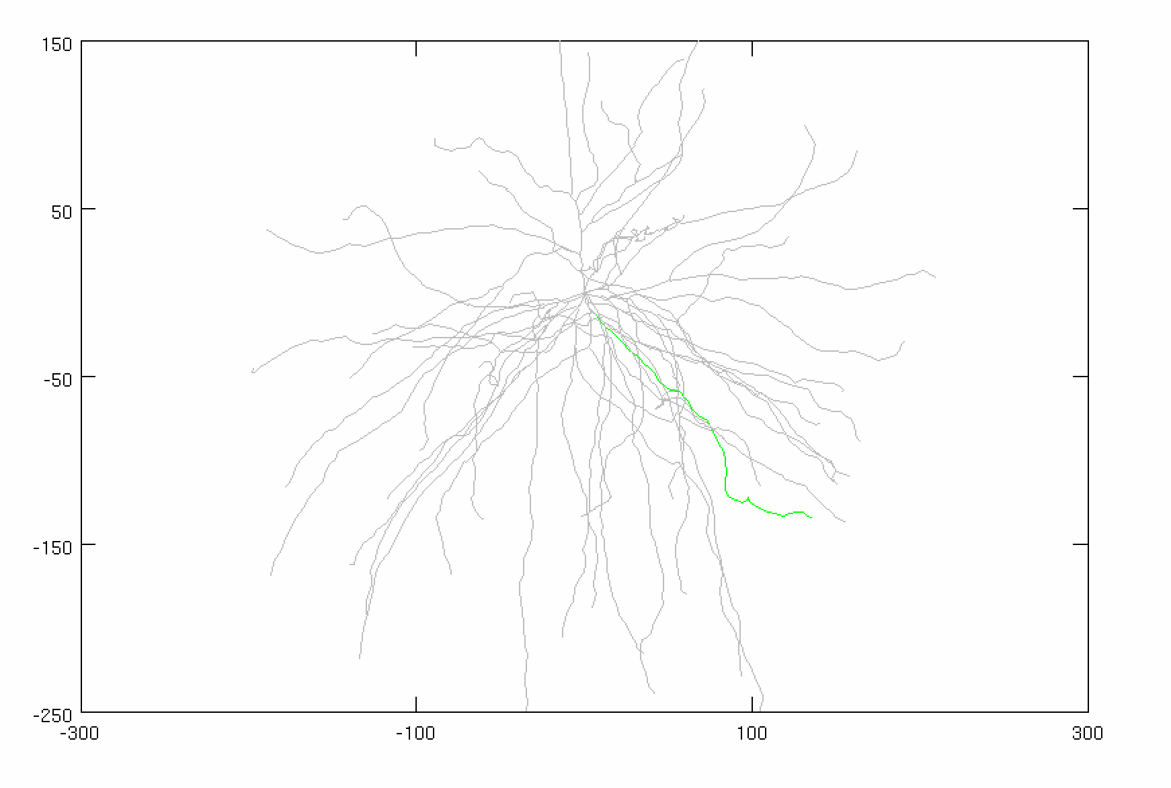
Model Parameters
Inhibitory Gamma
N_syn = 30 (ON SOMA)
Firing rate: 50 Hz
Distribution: 3 ms
Conductance: 0.005
Adjusted Current
Amplitude: 1.875 nA
Noise: 0 nA
Stimulus
Total synapses: 40 synapses
AMPA: 0.0015 µS
NMDA: 0.0039 µS
Firing rate: 50 Hz
Start Time: 5 ms
Noise: 0 ms
Location: VARIABLE
AVG: 25 trials
CONSTANT

Slide 4
CASE #1: Excitatory Dendrites Fixed at Halfway Along Dendrite

Slide 5
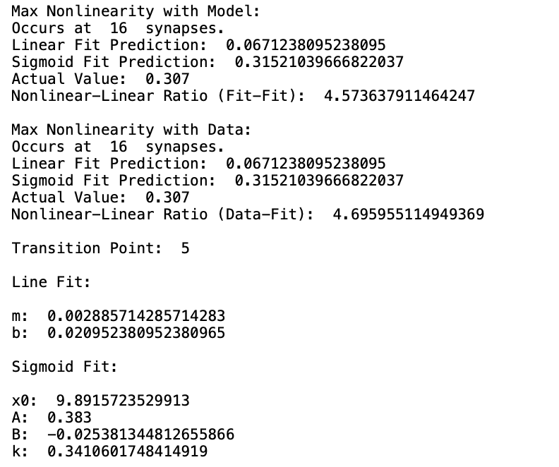
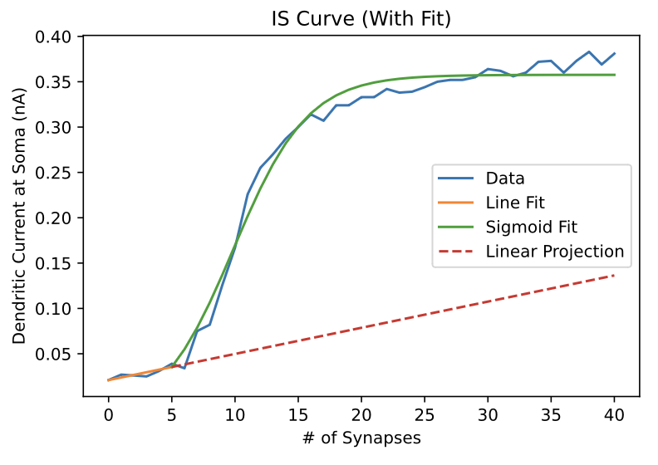
CASE #1: Excitatory Dendrites Fixed at Halfway Along Dendrite

Slide 6
CASE #2: Excitatory Dendrites Randomly Placed Along Dendrite

Slide 7
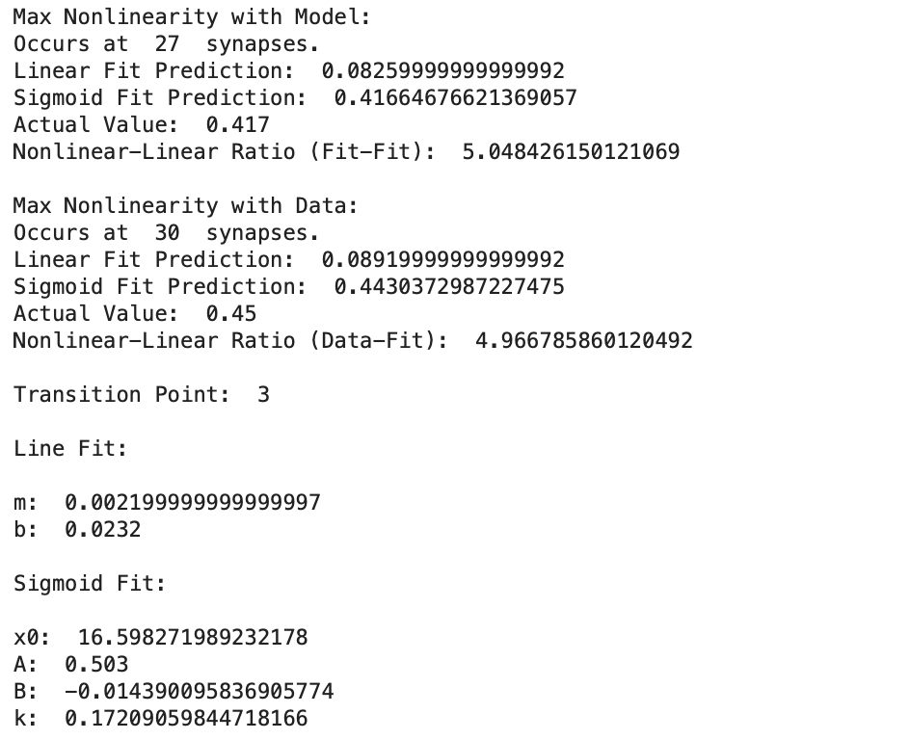
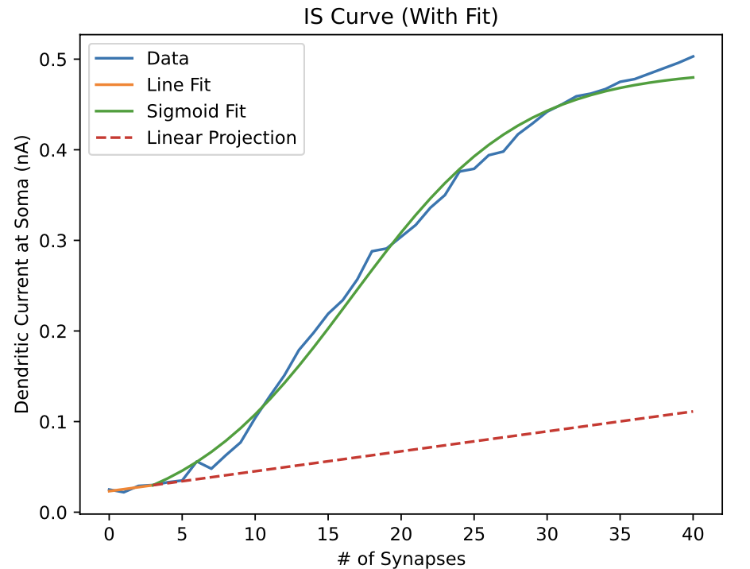
CASE #2: Excitatory Dendrites Randomly Placed Along Dendrite

Slide 8
CASE ANALYSIS

